Slide 1

Variability of Housing Prices during Covid Period
MIS 6380.501 Group No. 3
Raja Sri Krishna Chaitanya Ayachitula
Antrika Bachloo
Koti Reddy Gangasani
Varshini Ramesh
Sudeeksha Golla
Srinivas Medapalli
Hruthik Kumar Rudravaram

Slide 2
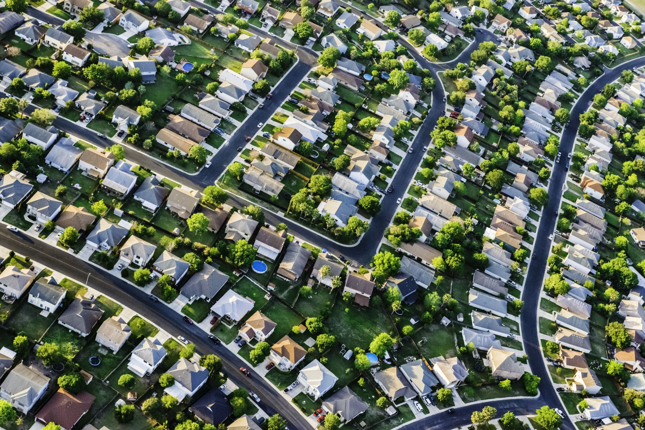
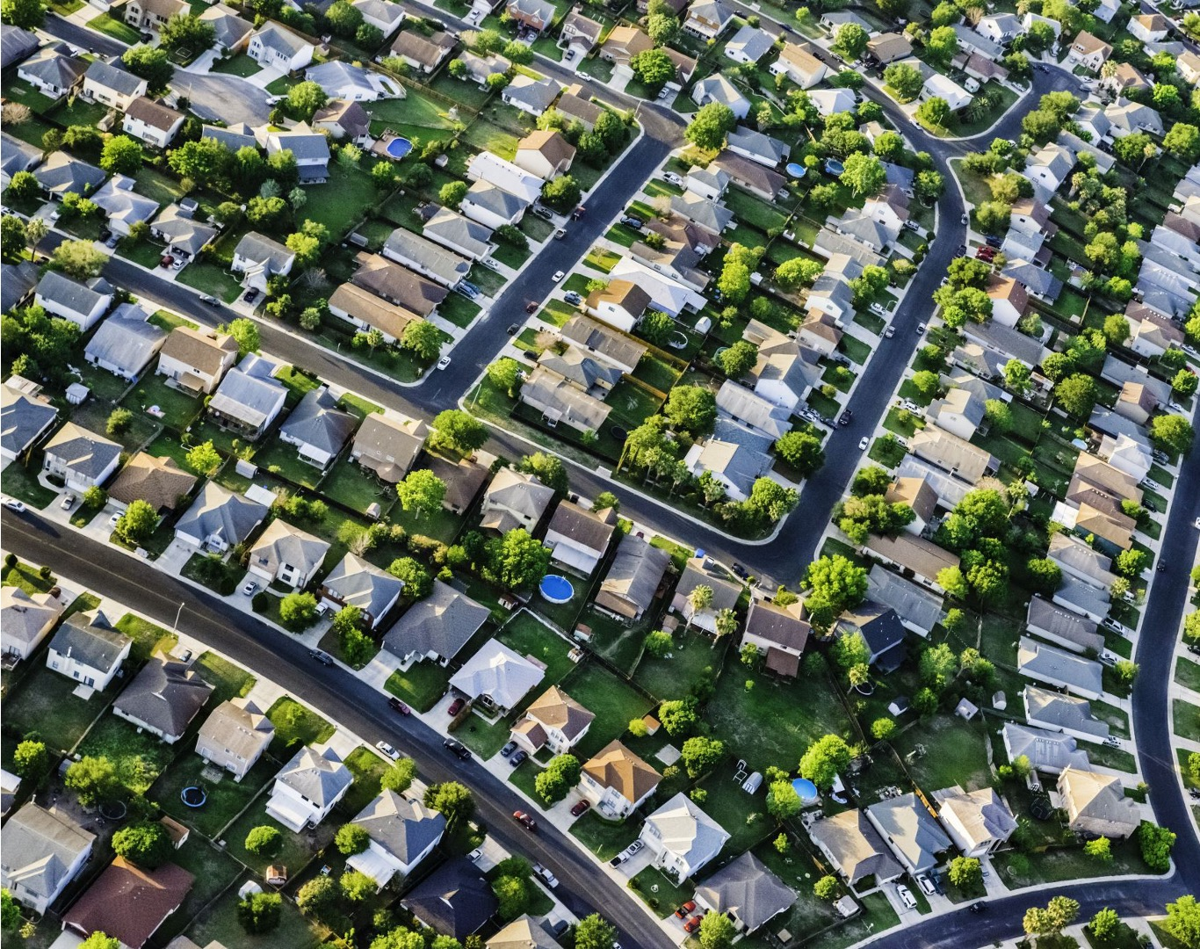
Objective:
To understand whether there is a change in housing price after and during the onset of Covid pandemic (2020-2022) and population in the state of Texas and California.

Slide 3

Data Acquisition
Primary dataset:
Zillow Data set for housing prices (https://www.zillow.com/research/data/)
Secondary datasets:
Zillow Data set for rental data (https://www.zillow.com/research/data/)
Interest rates data from Federal Funds (https://fred.stlouisfed.org/tags/series?t=interest+rate%3Bmonthly%3Busa)
State level population dataset (https://www.ers.usda.gov/data-products/county-level-data-sets/county-level-data-sets-download-data/)
Consumer Price Index data from USA bureau of labor (https://www.bls.gov/cpi/data.htm)
Number of Records:
Housing Dataset - 8160 of 512,808 records (Selected Texas and California records from all states in the US)
FED FUND rate data set - 50 rows (from Jan 2019 to Jan 2023)
Rental data set - 899 rows
US Population Data - 3281 rows (in the years 2010, 2020 and 2021)
Consumer Price Index Data – 800,438

Slide 4

Data Manipulation
Preprocessing tools:
Python
Excel
Visualization tool:
Tableau

Slide 5

Hypothesis

Slide 6

The housing prices in the state of Texas and California have increased from 2020 to mid-2022 during the covid period.
There has been significant increase in the housing prices in both California and Texas over the covid period.
The percentage increase in housing prices in Texas is 123% and 200% in California.

Slide 7
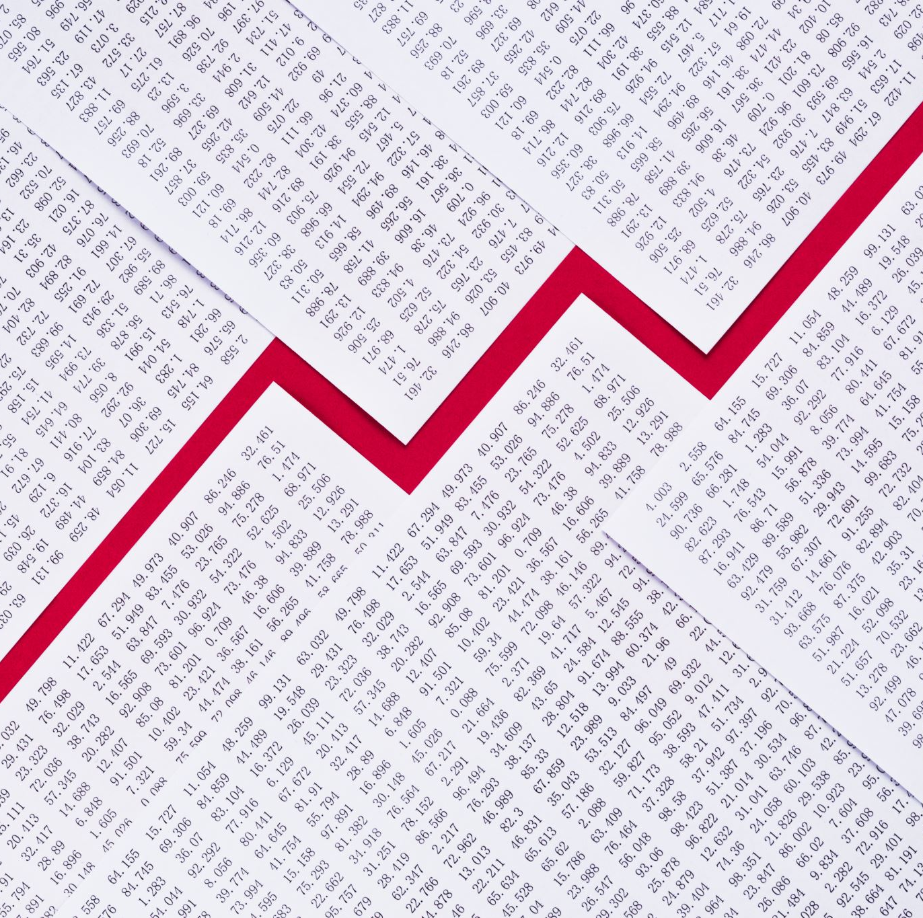
The housing prices increased gradually in the period 2020 – 2022 because of the decrease in interest rates.
Due to a heavy dip in the interest rates, the housing prices have significantly increased in the covid period.

Slide 8

Whether the change in prices of 4 bedroom and higher number of bedrooms is more than in one-, two- and three-bedroom houses because of increase in population in Texas.
Due to increase in population rate and high gentrification, there was a significant increase in the housing prices.

Slide 9

The housing price index have increased from 2020 to mid-2022 due to increase in consumer price index.
During the COVID-19 pandemic, there have been significant impacts on both the housing market and the overall economy, which are reflected in the housing price index and the consumer price index, respectively.

Slide 10

The rental prices have increased during the covid period in different counties in Texas due to Covid outbreak.
The rental prices in Texas increased during the COVID-19 pandemic period due to changes in demand and supply dynamics, economic conditions, and policy interventions.

Slide 11

Conclusion
Decrease in interest rates, increase in consumer price index, increase in population and gentrification influenced the changes in housing and rental prices in Texas and California during the covid period.

